Slide 1
Emotional Intelligence

Slide 2
Agenda
What is Emotional Intelligence?
Why is it important?
Different between EQ and IQ?
Triggers for emotions and how our brain reacts to it?
Small Exercise around Know Yourself

Slide 3
What is EI?
Know your emotions
Know yourself
Knowing one’s strengths
Knowing one’s areas of improvements

Slide 4
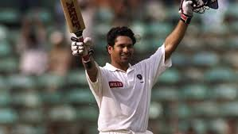
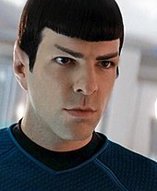
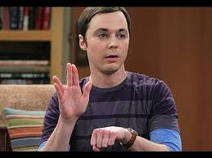
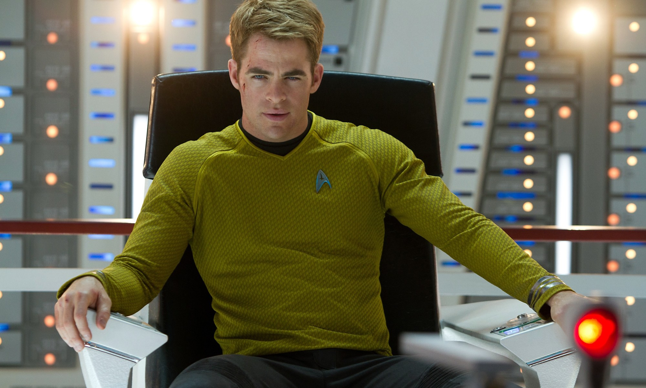

Slide 5
Feedback & Questions?

